Slide 1
Sidmouth 2026

Slide 2
Druk op spaciebalk voor volgende foto

Slide 3
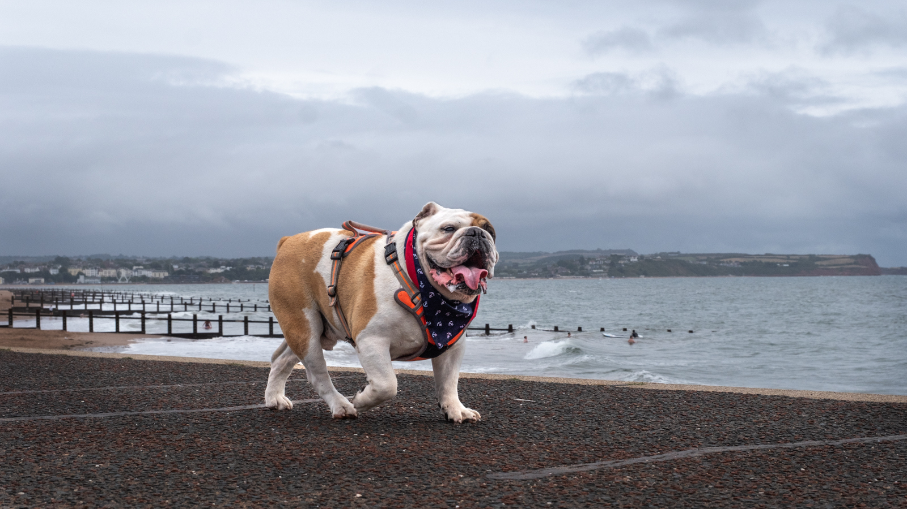

Slide 4
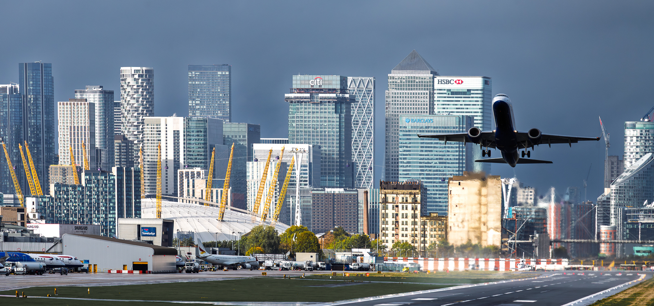

Slide 5
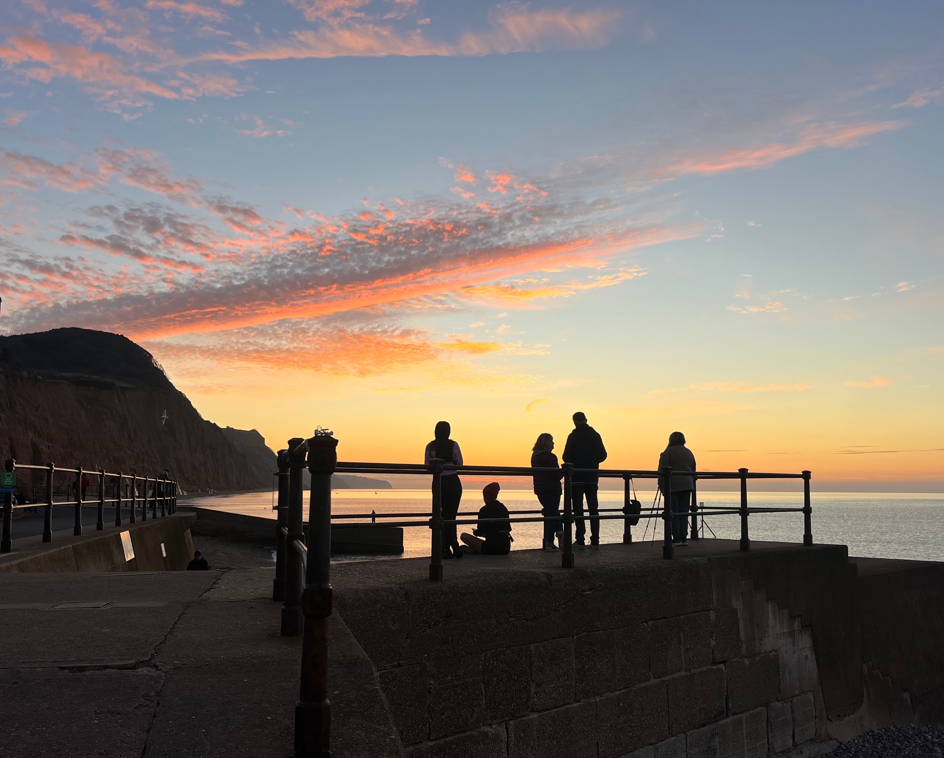

Slide 6
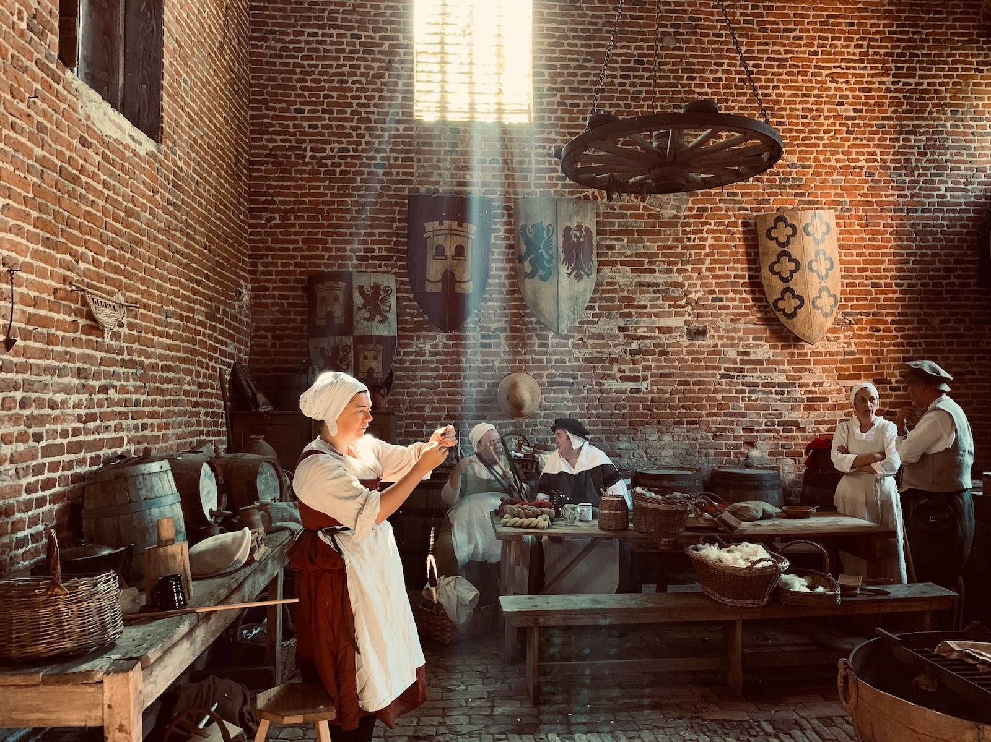

Slide 7
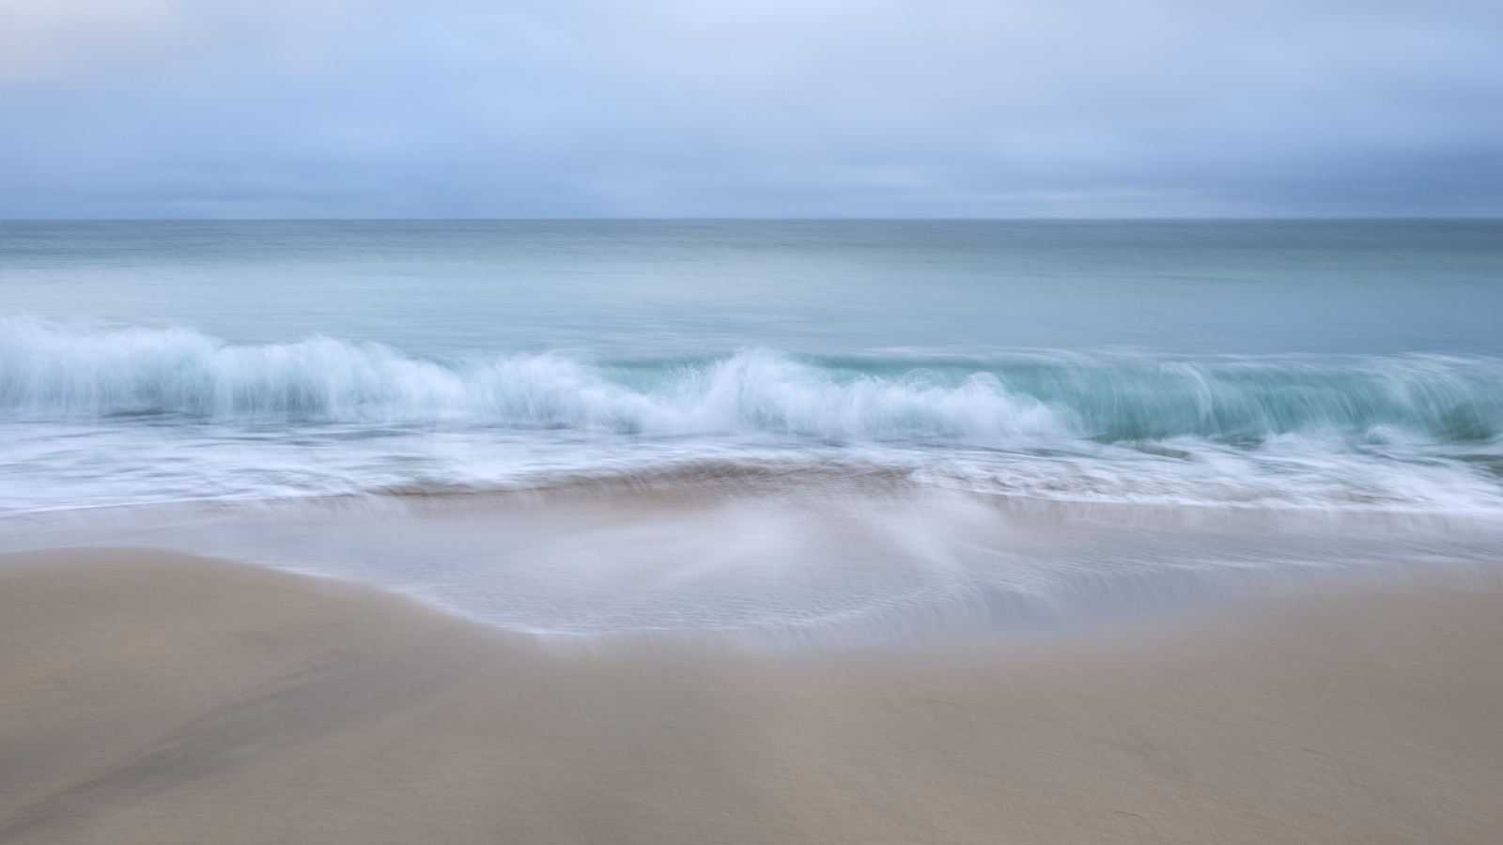

Slide 8
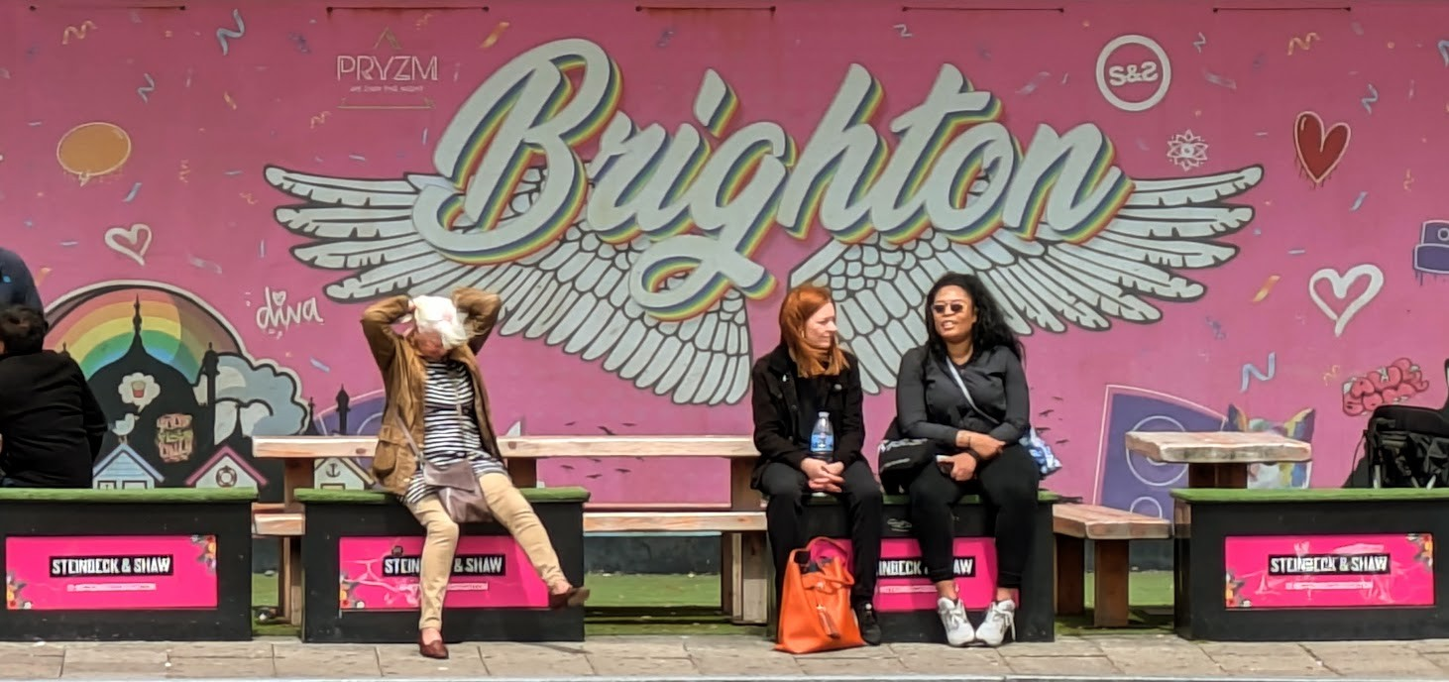

Slide 9
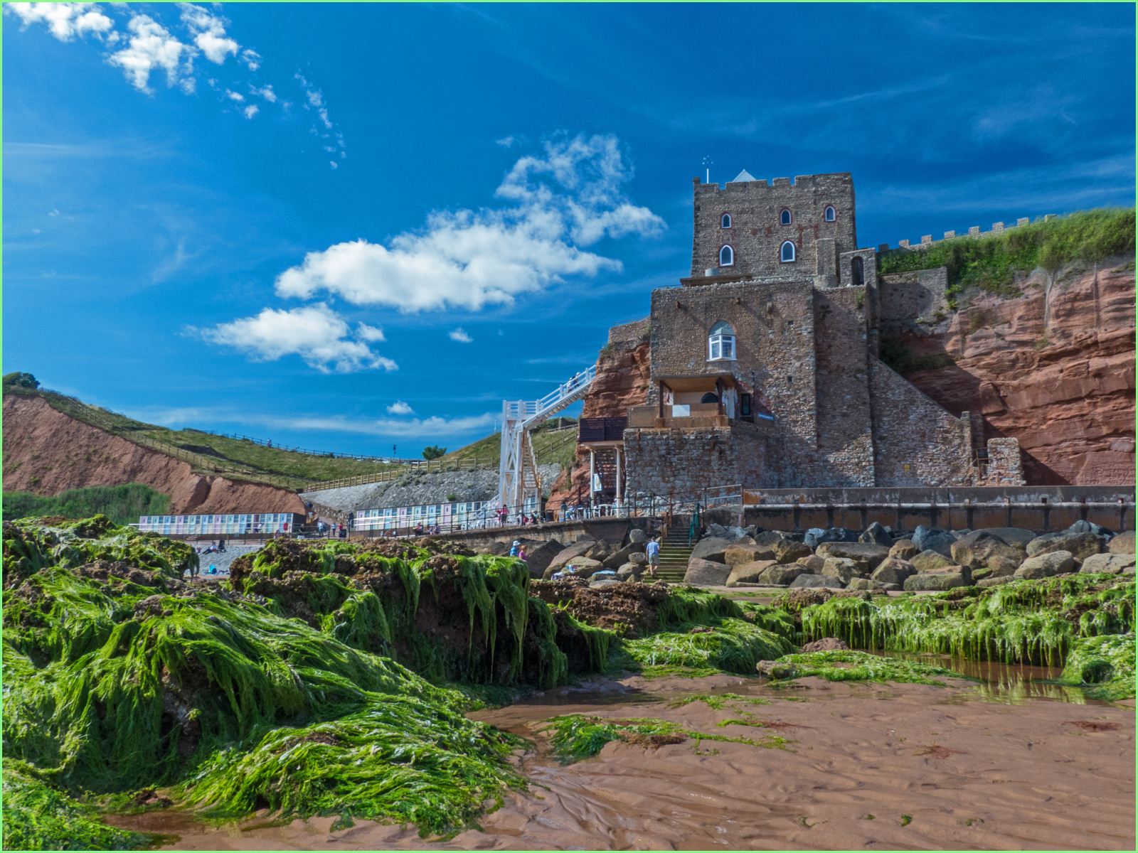

Slide 10
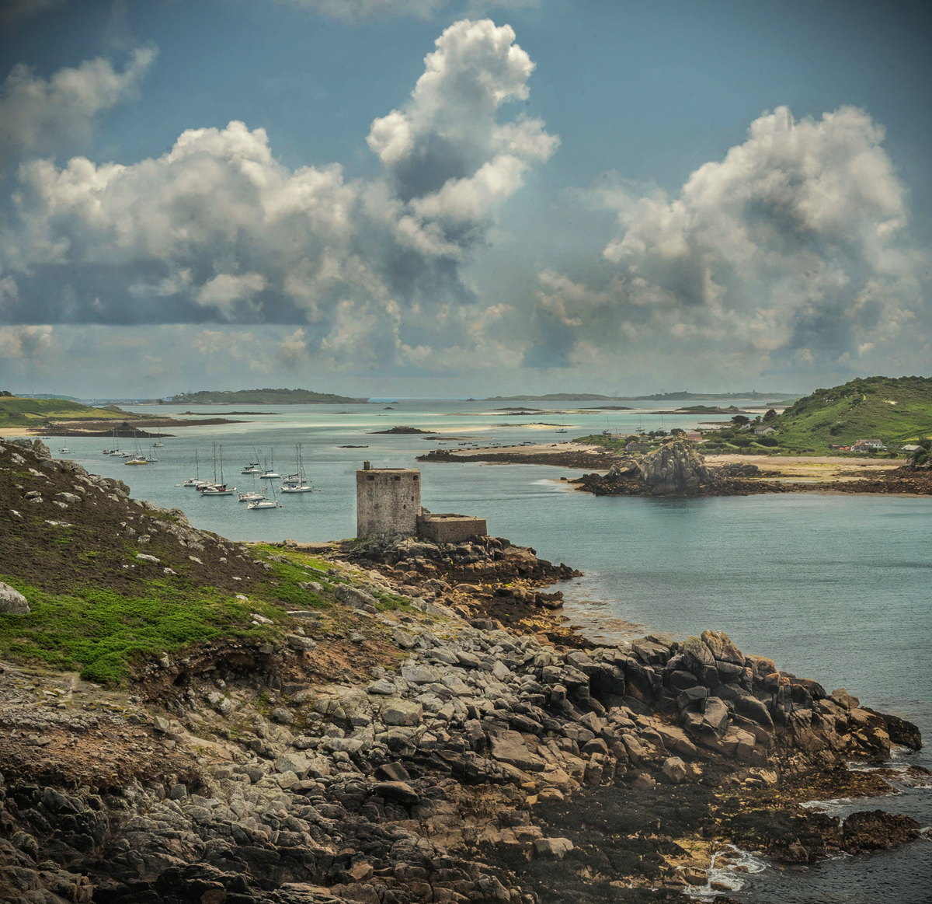

Slide 11
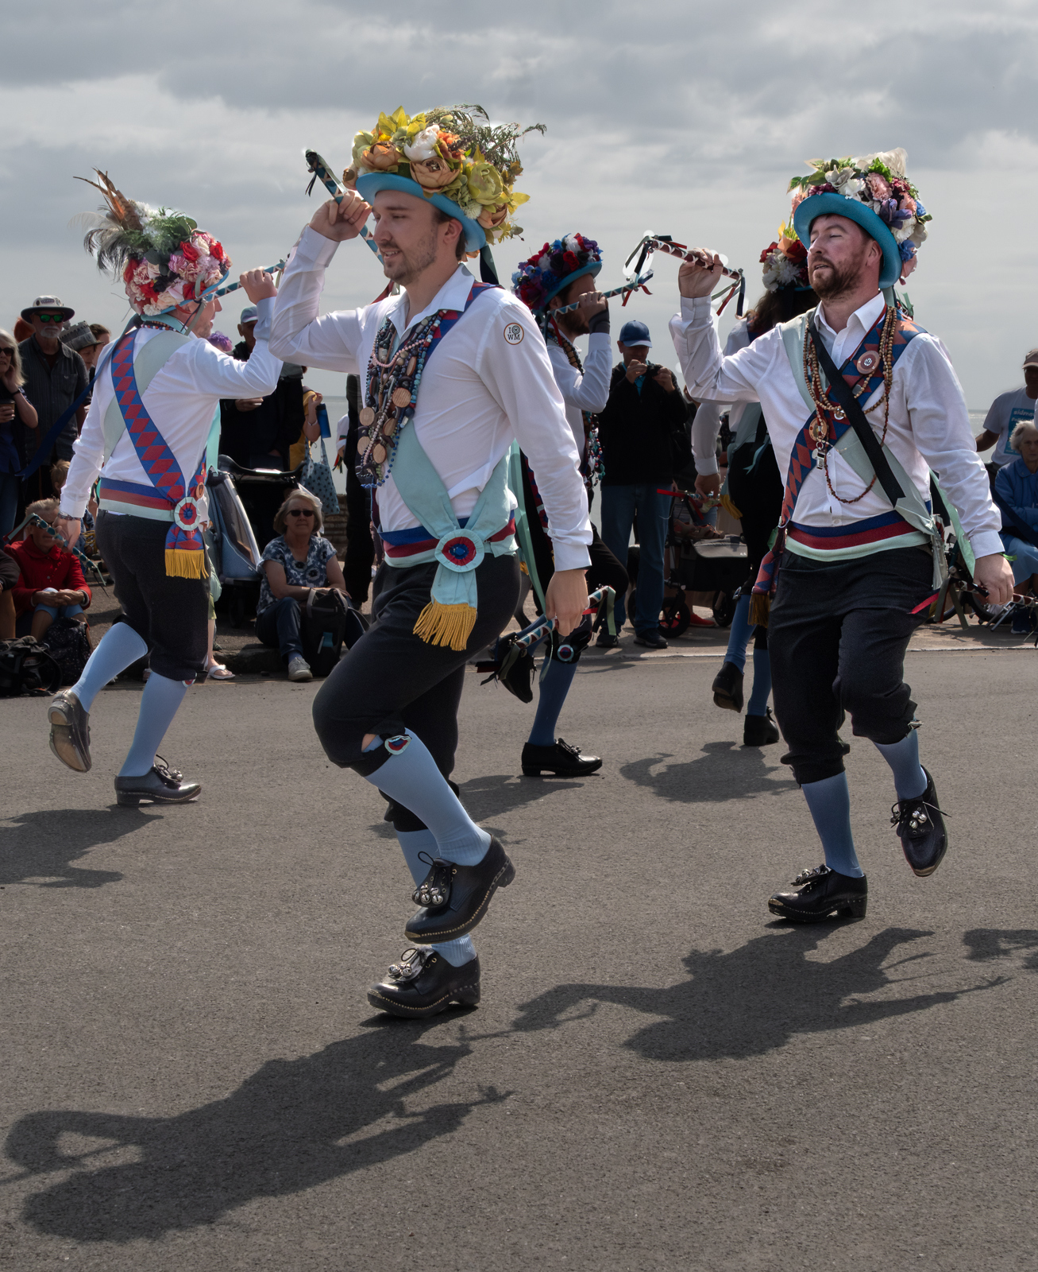

Slide 12
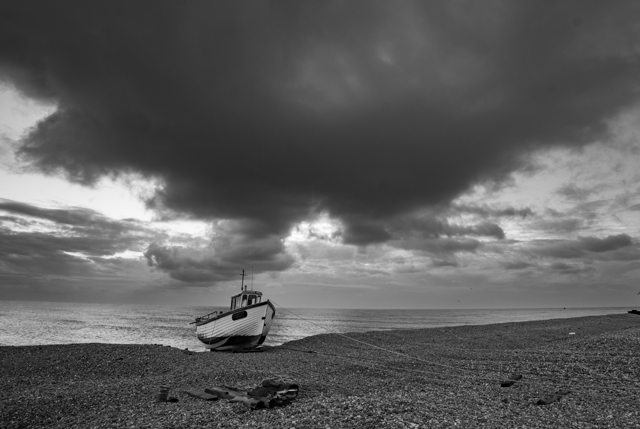

Slide 13
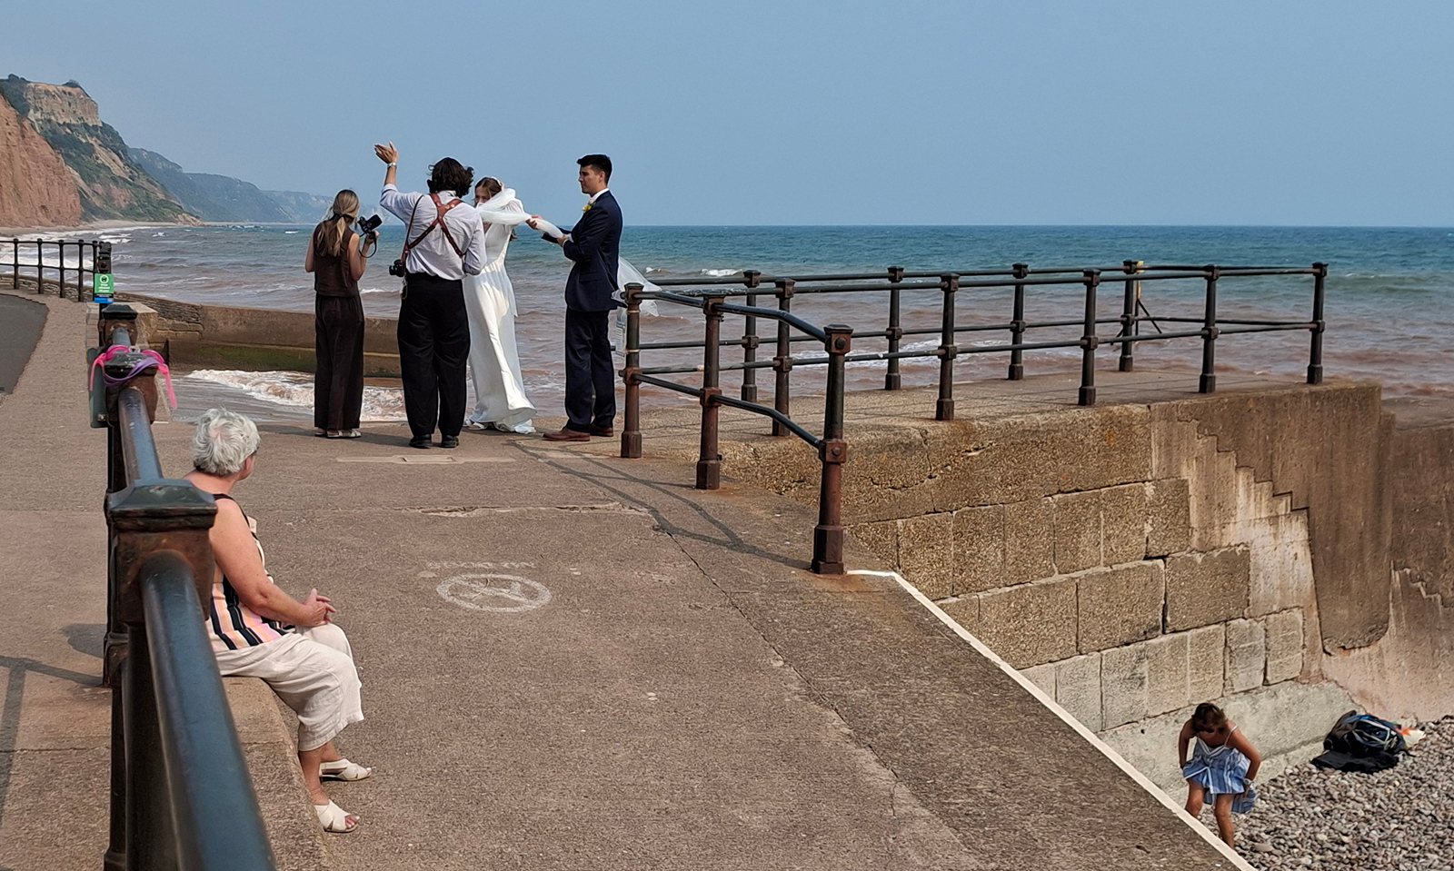

Slide 14
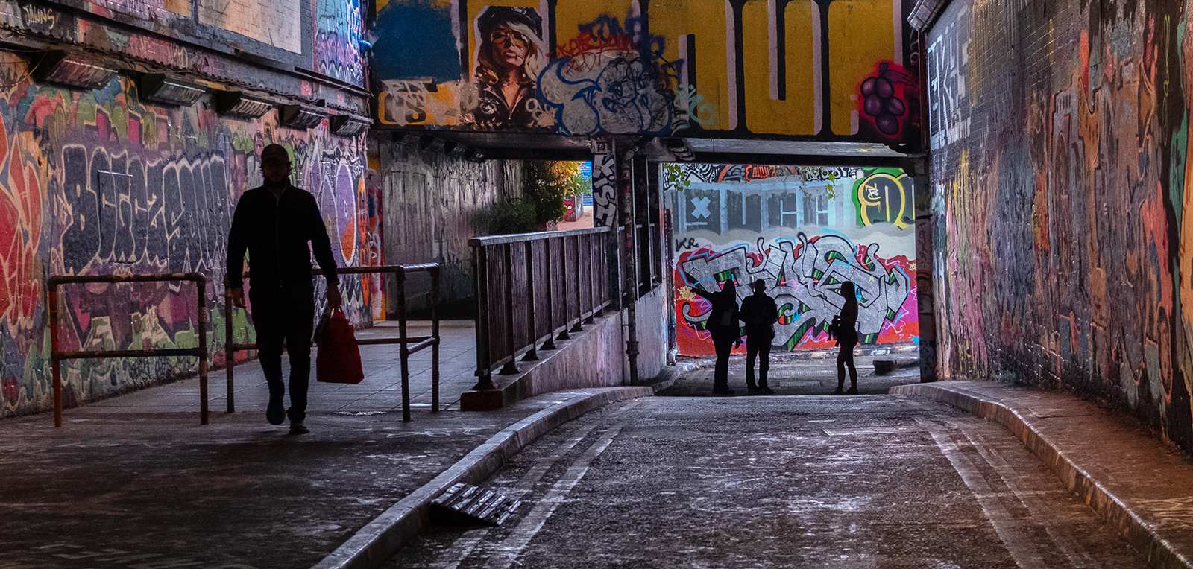

Slide 15
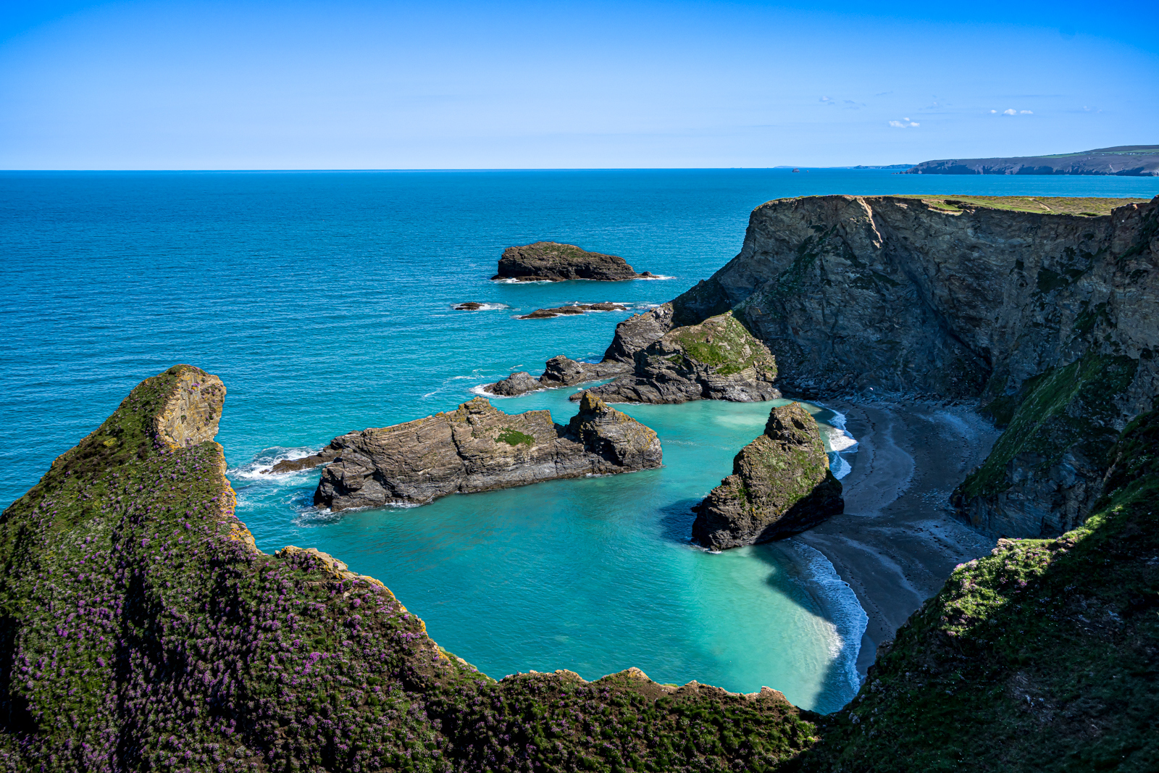

Slide 16
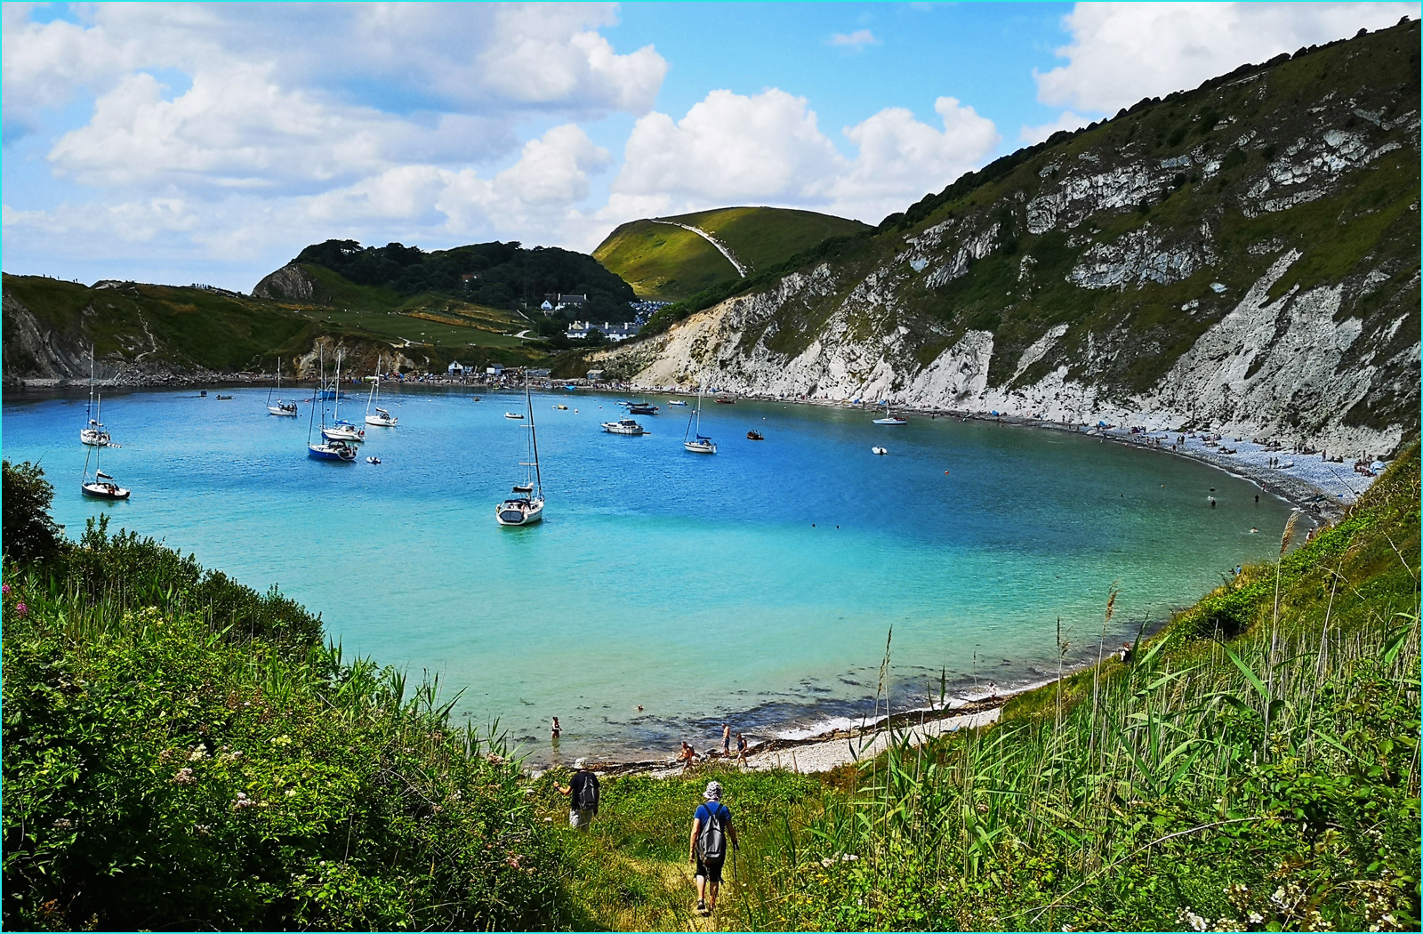

Slide 17
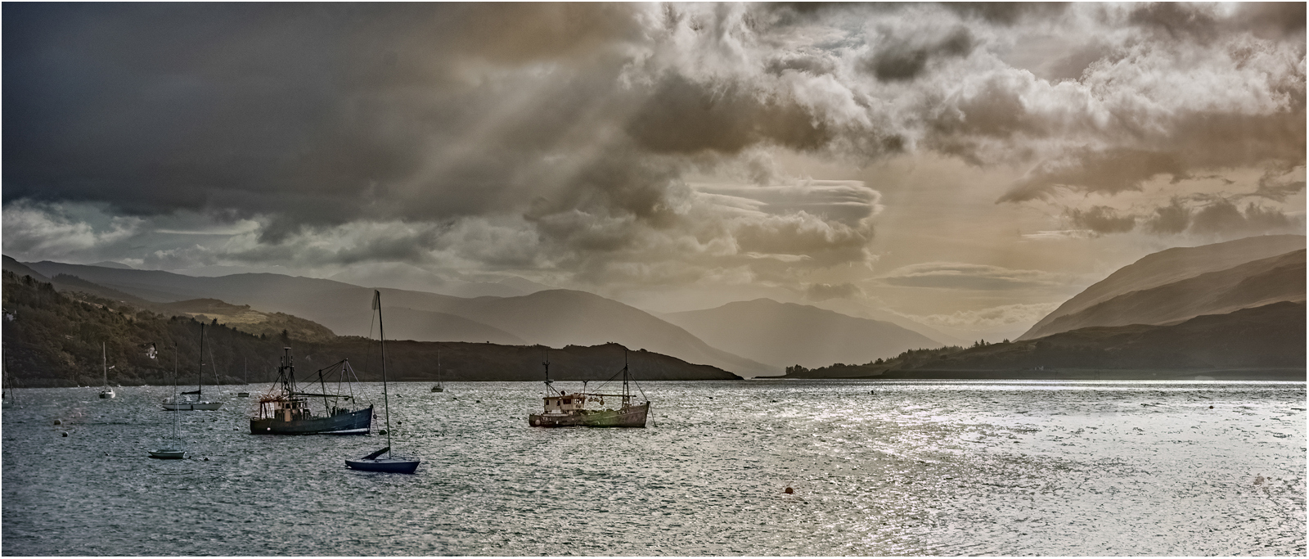

Slide 18
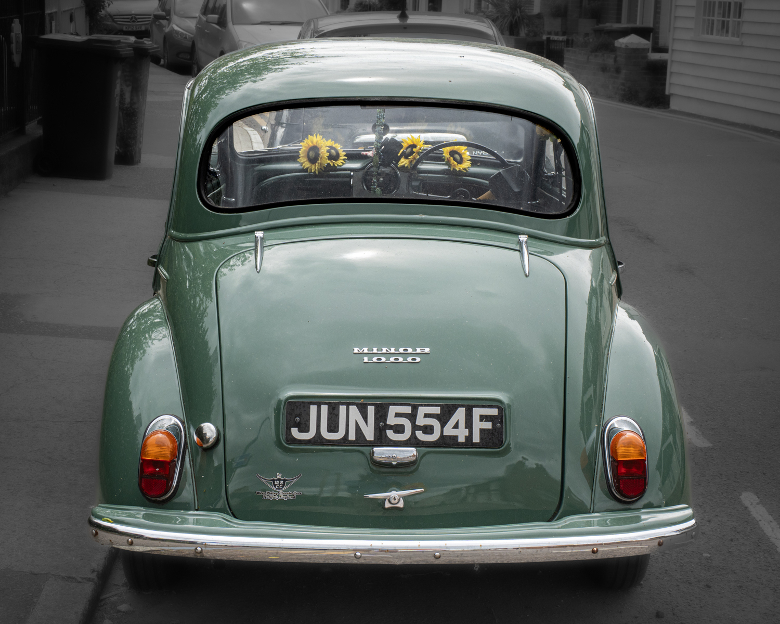

Slide 19
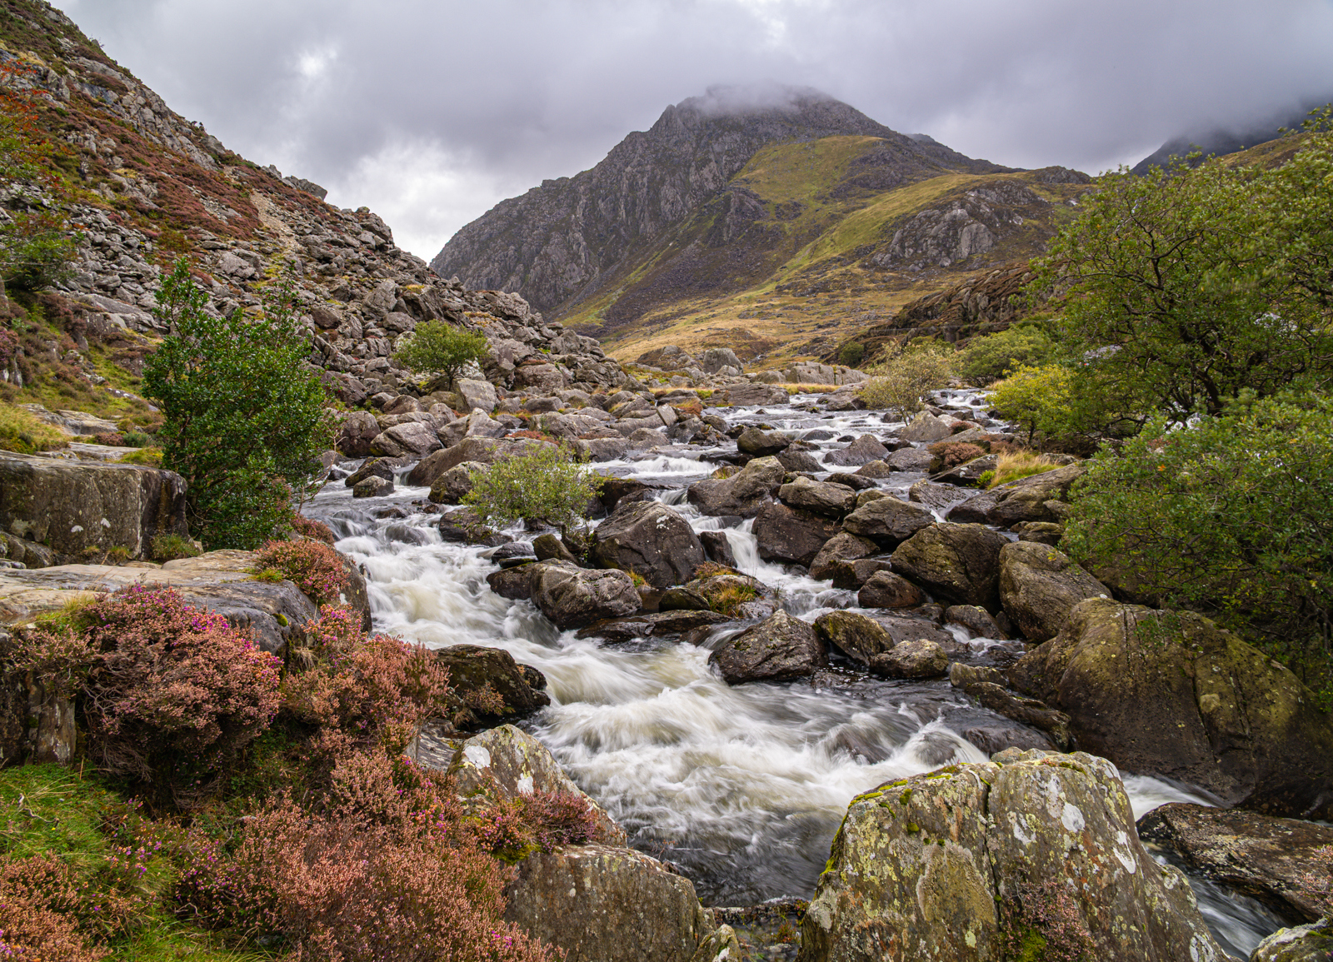

Slide 20
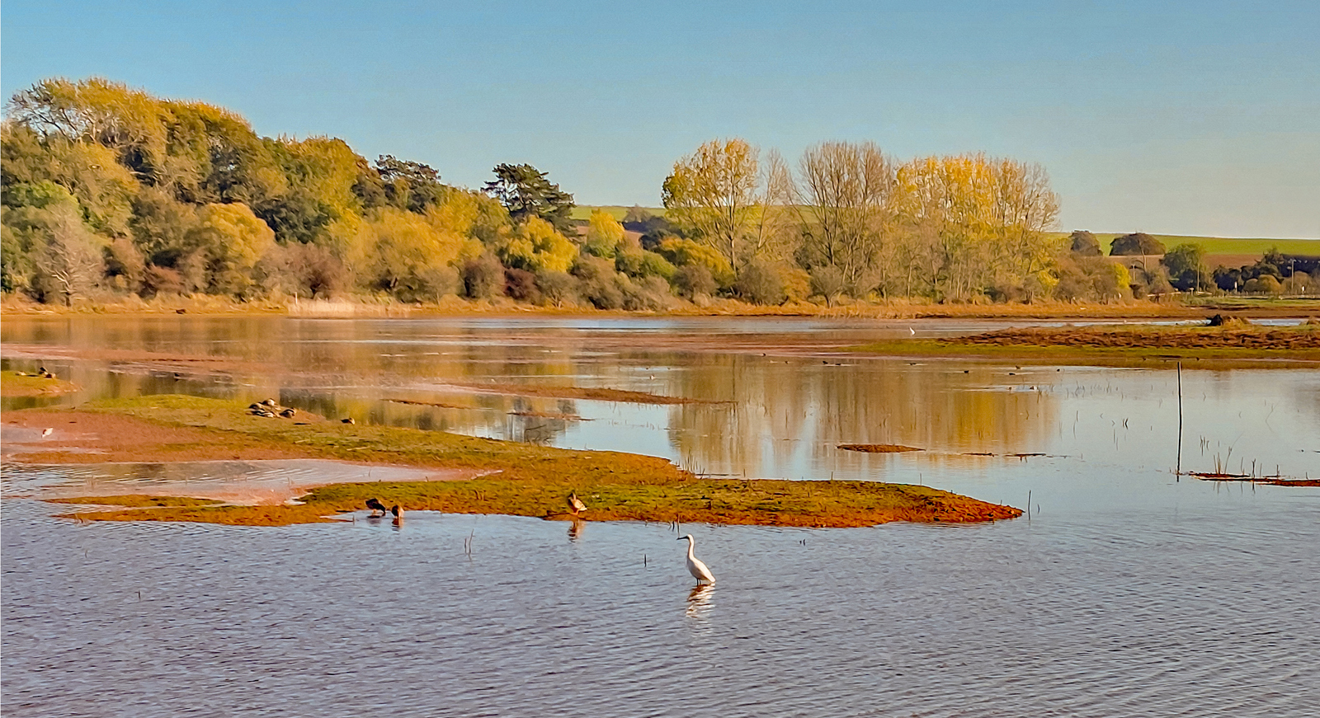

Slide 21
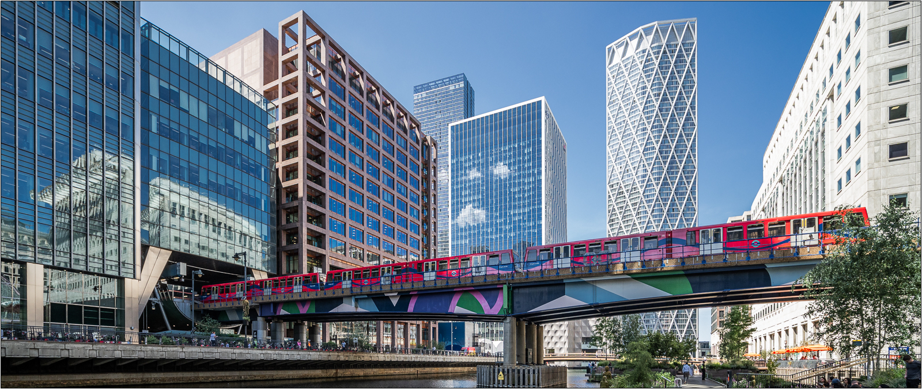

Slide 22
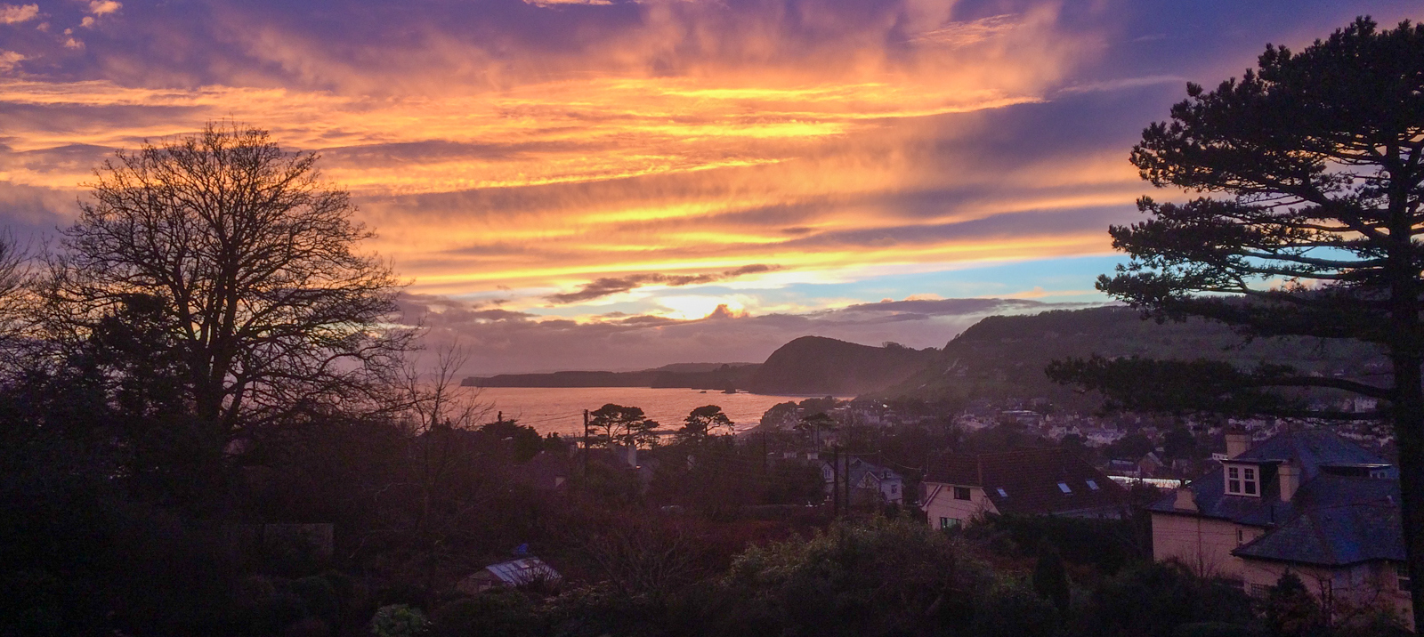

Slide 23
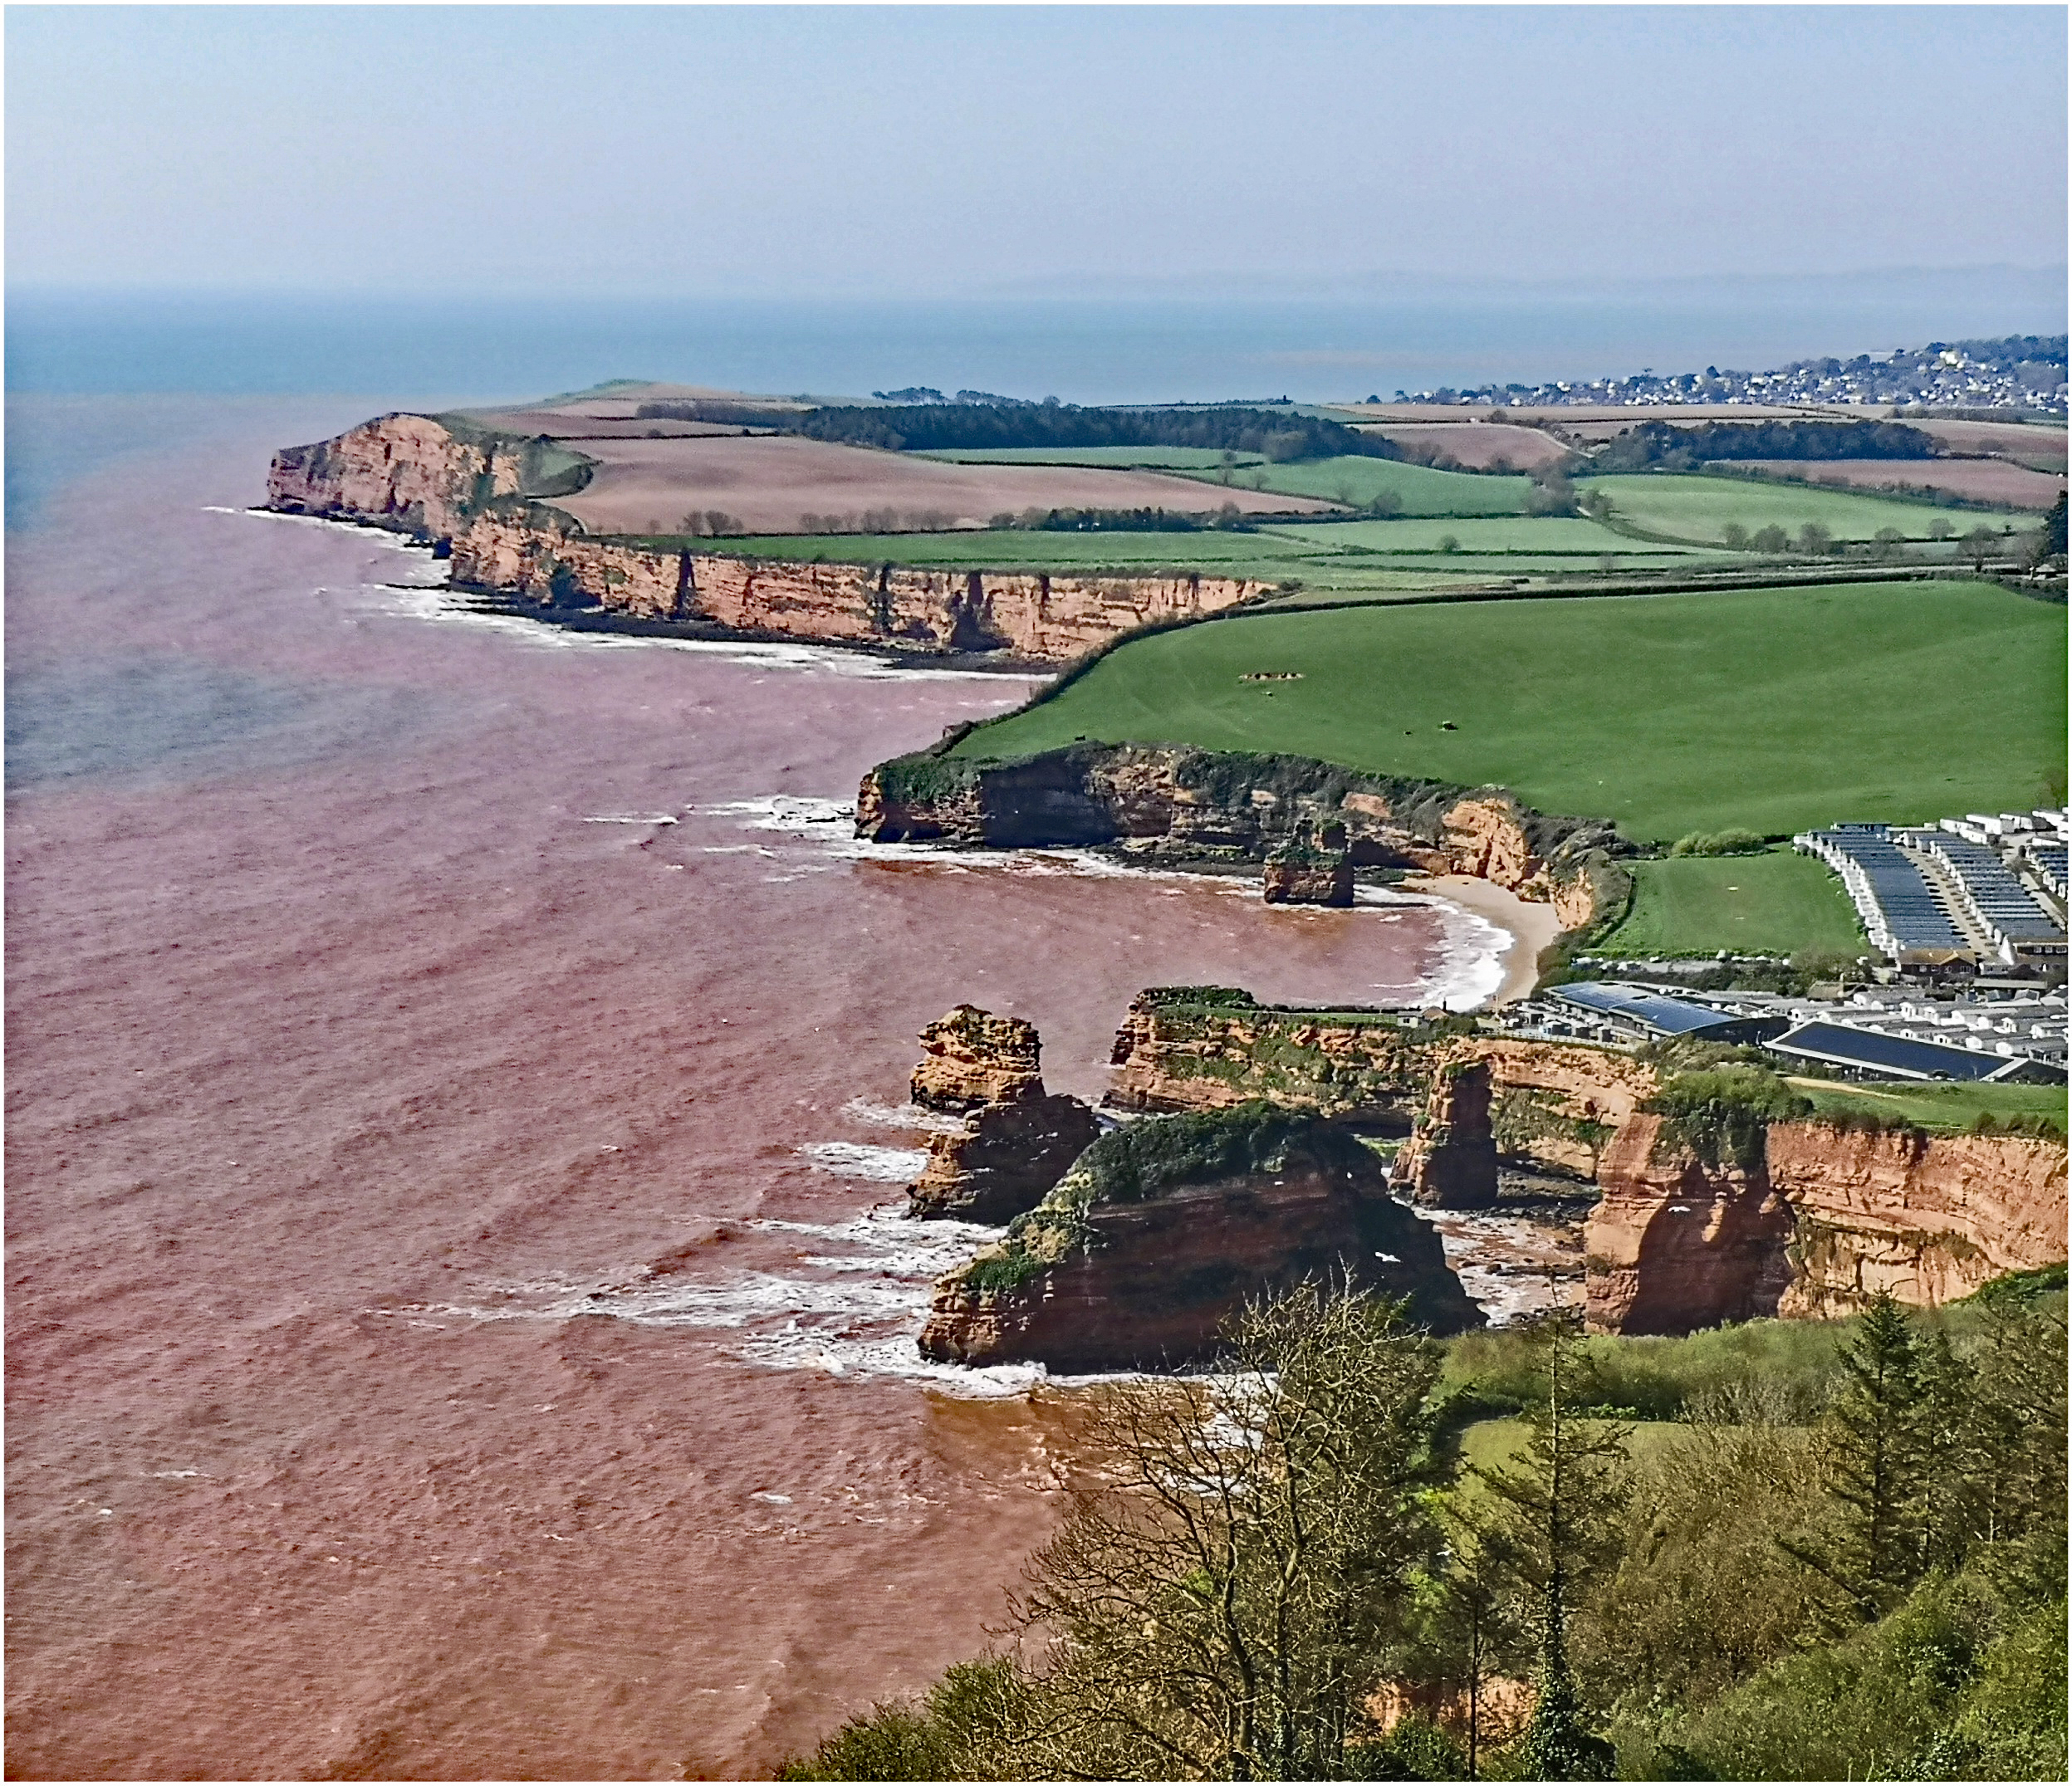

Slide 24
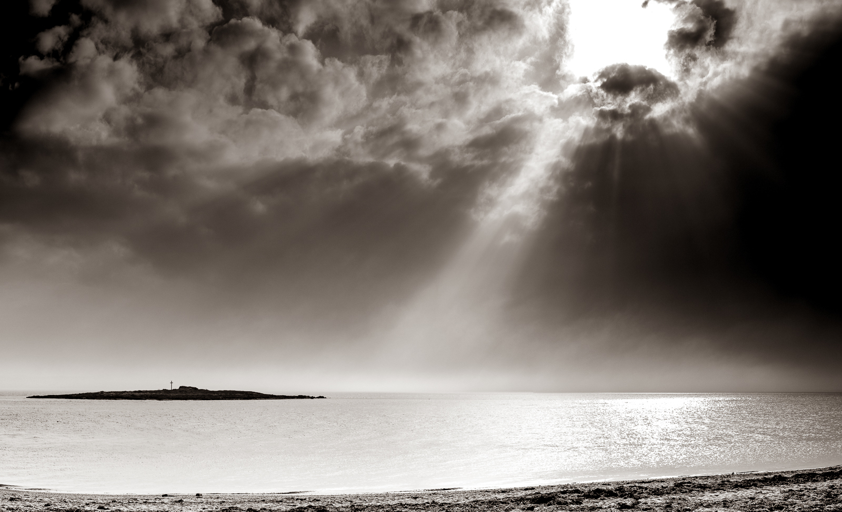

Slide 25
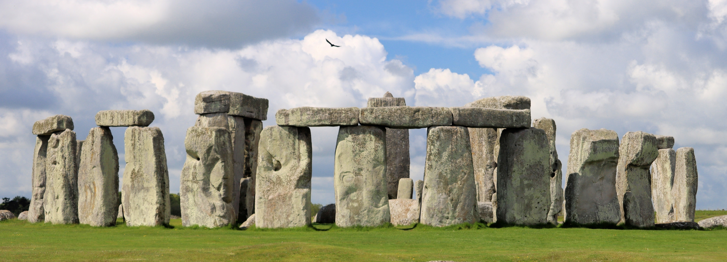

Slide 26
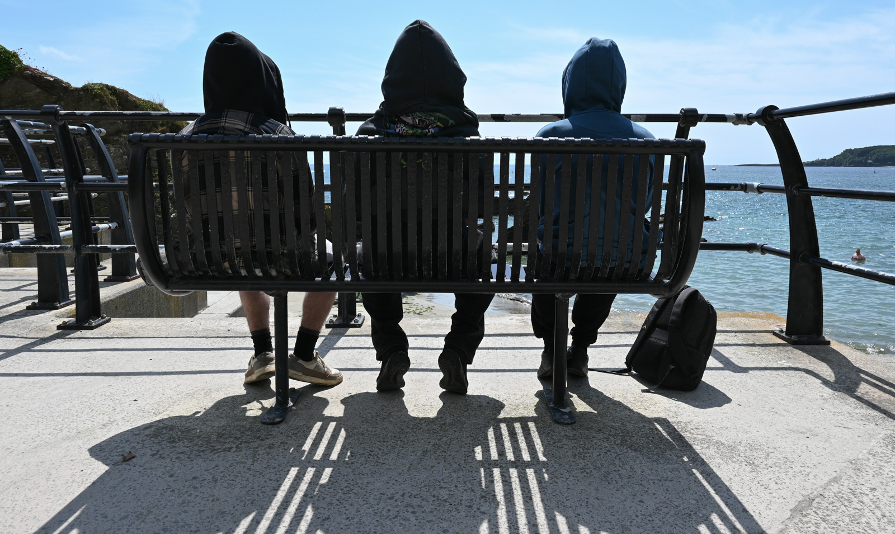

Slide 27
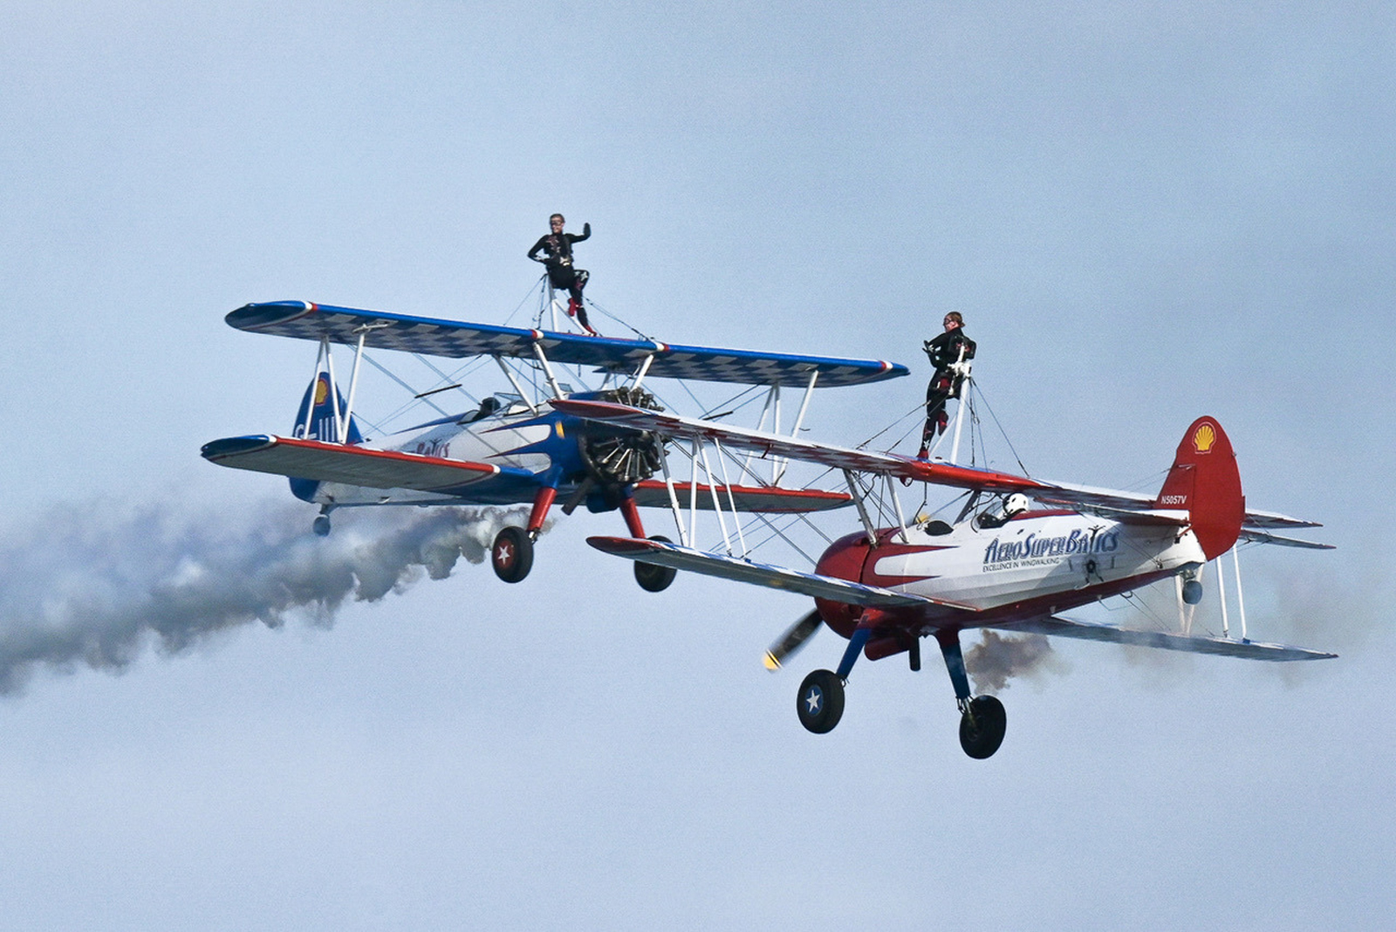

Slide 28
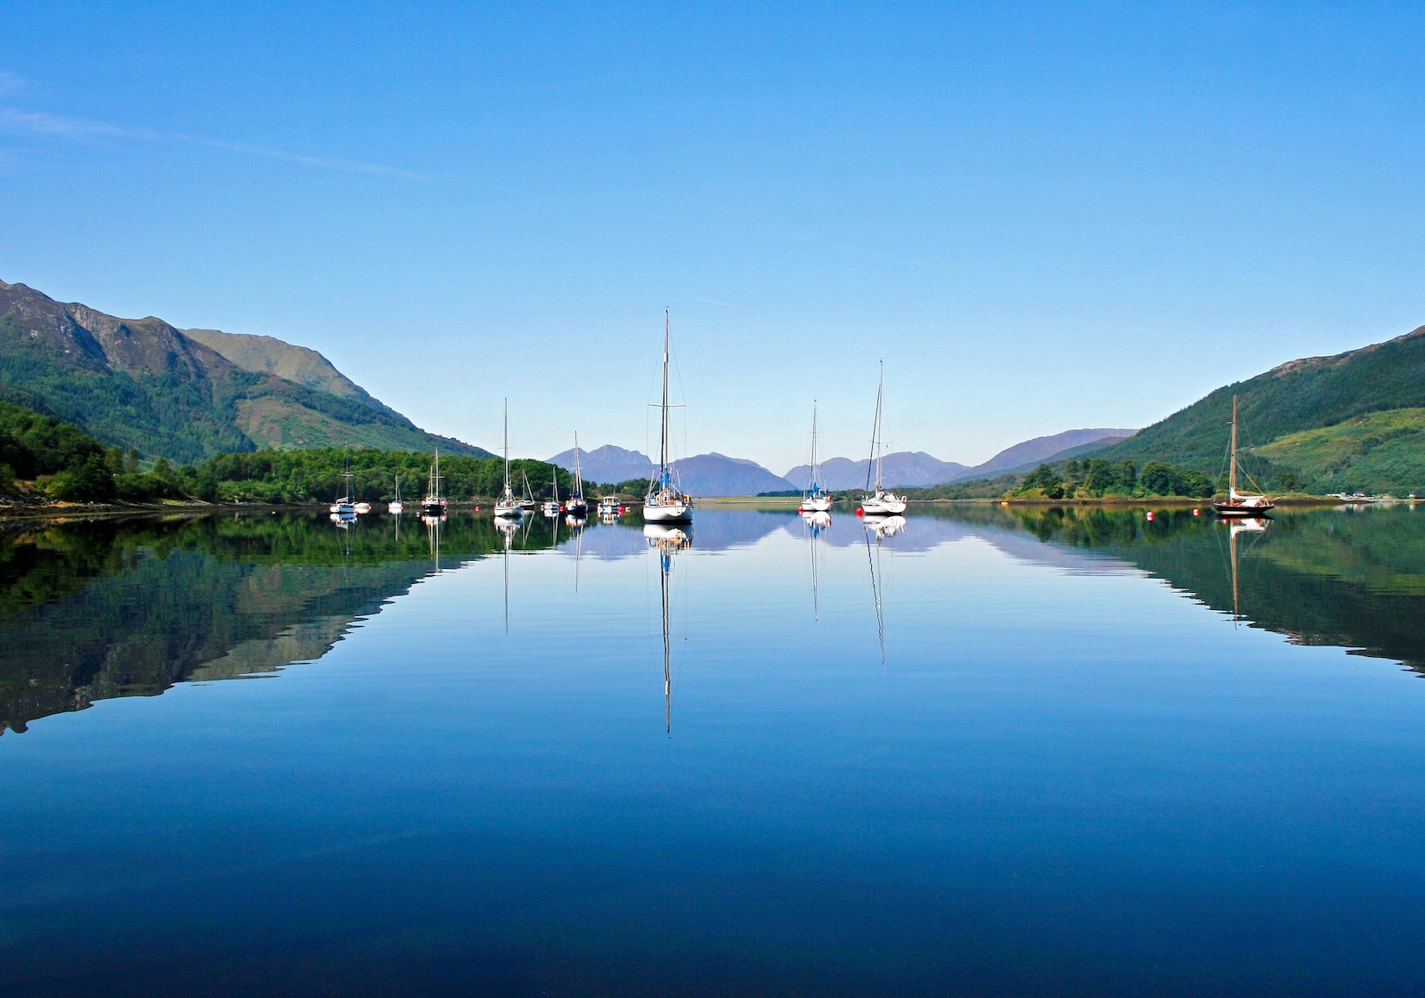

Slide 29


Slide 30
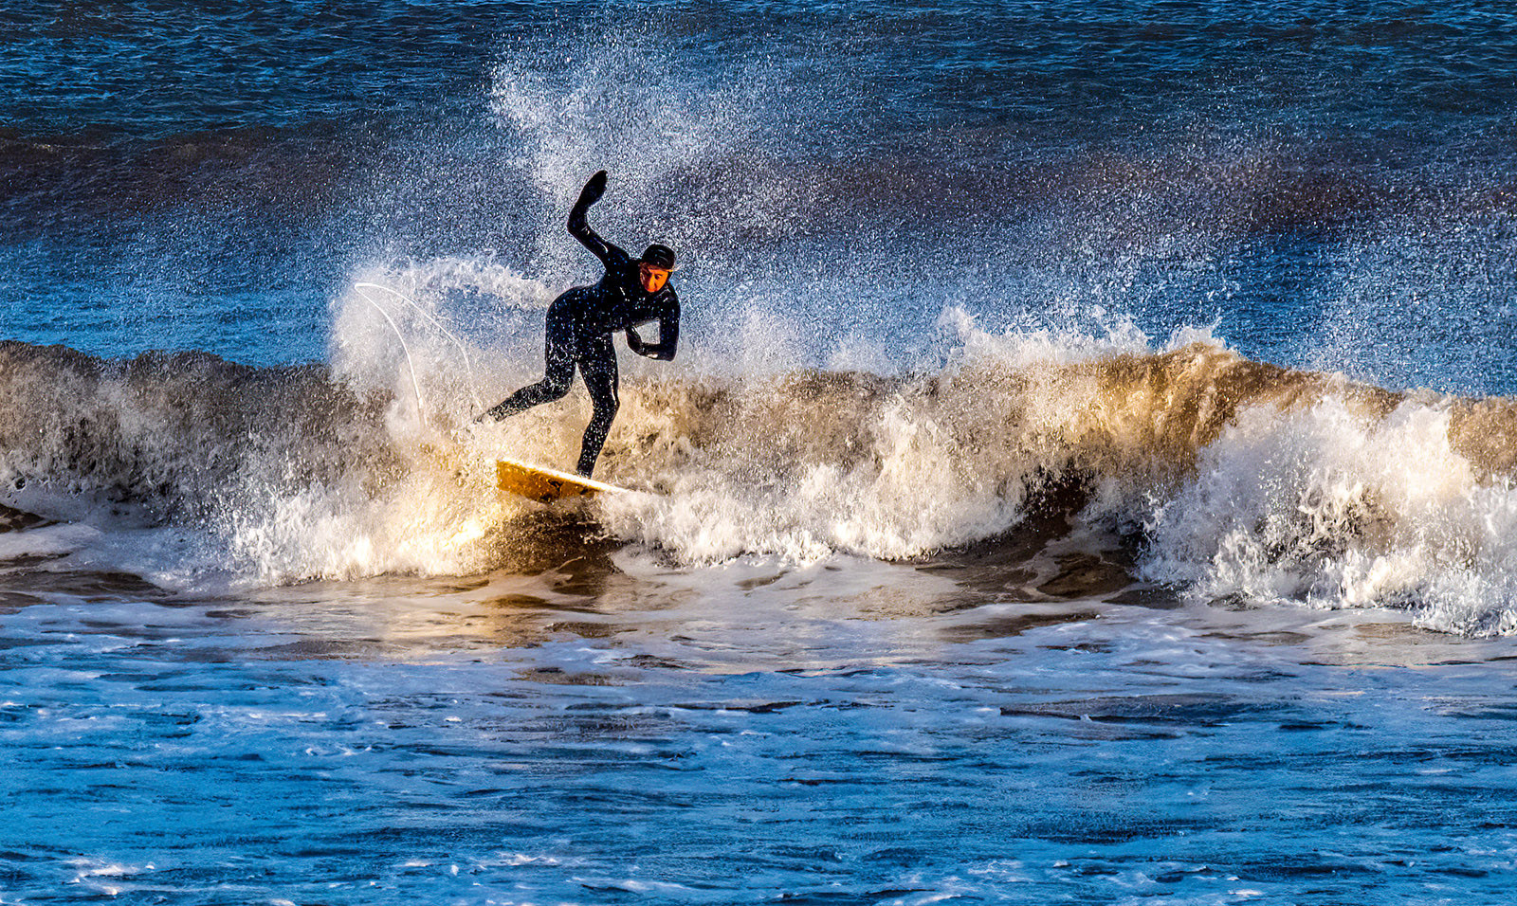

Slide 31
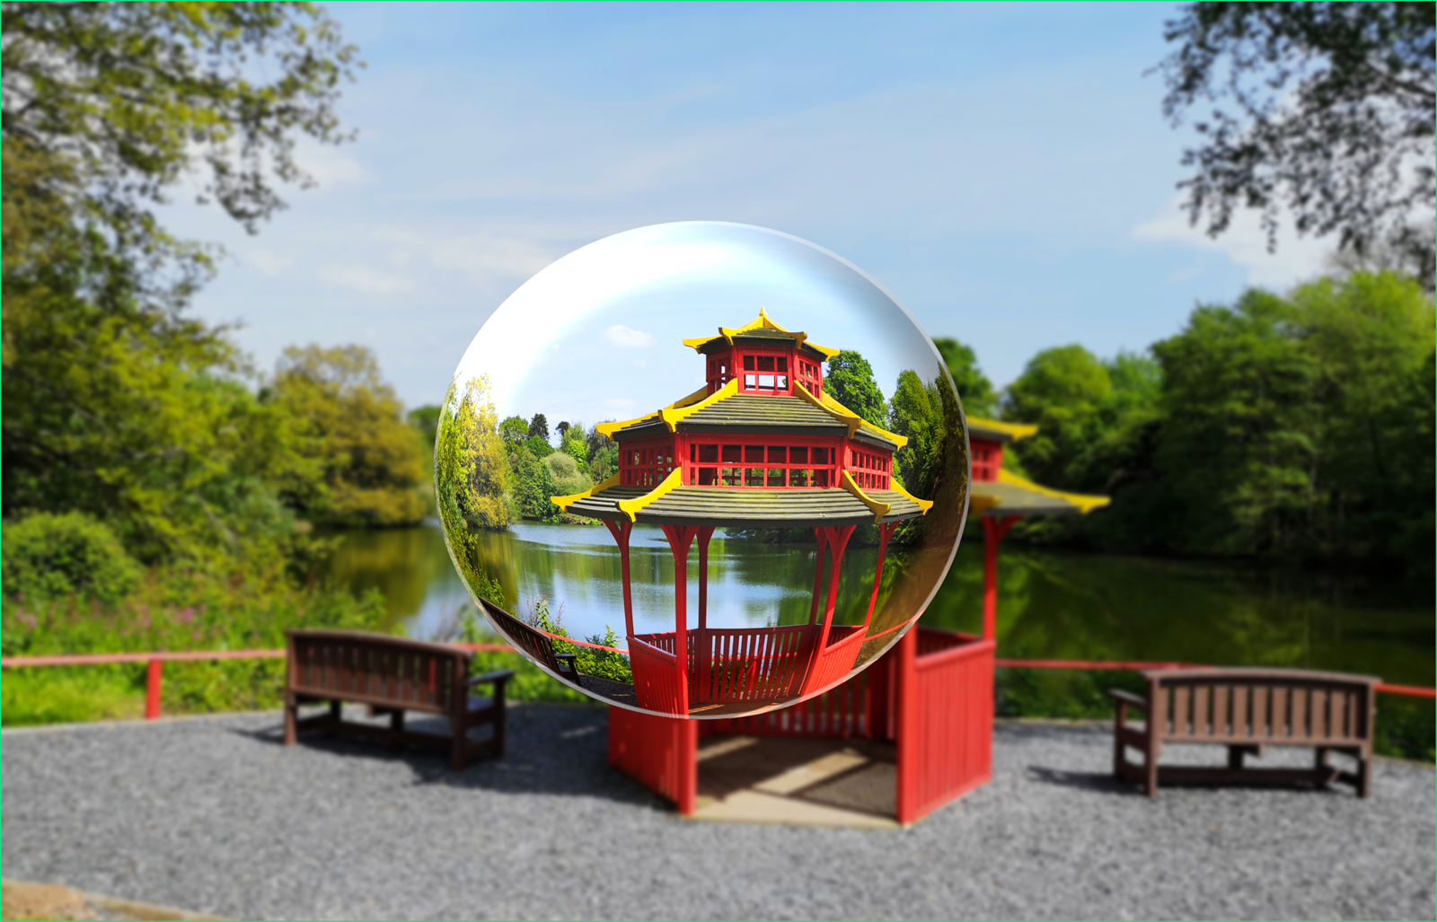

Slide 32
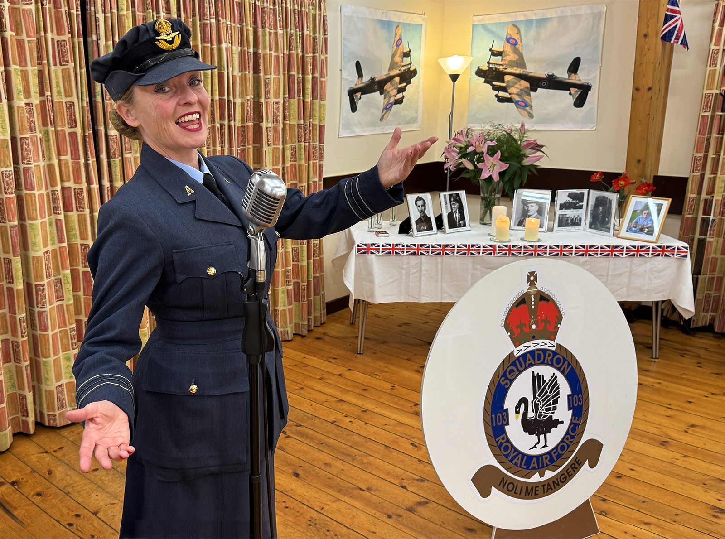

Slide 33
Sidmouth 2026 met titel foto en naam auteur

Slide 34
1 Andy Carmichael - Sexy Beast in Dawlish Devon

Slide 35
2 Aviation And Architecture London City Airport looking towards Canary Wharf- Brian Sherlow

Slide 36
3 Awaiting sunrise in Sidmouth - Melissa Newman

Slide 37
4 Back in Time, Kentwell Hall, Tudor House in Suffolk- Tim Caves

Slide 38
5 Breaking wave_Sennen Cove_Suzanne Parsons

Slide 39
6 Brighton Vibes A Colorful Day in the City-Richard Foulkes

Slide 40
7 Jacobs Ladder at low tide in Sidmouth - Tony Velterop

Slide 41
8 Castle View - Isles of Scilly - Graham Lennox

Slide 42
9 Dancers Sidmouth Folk Festival.rosemarybudgell

Slide 43
10 Dramatic Skies over Dungeness - Bob Reynolds

Slide 44
11 dress undress-Sidmouth-DEast

Slide 45
12 Echoes Beneath the City_London_ Leake Street, a space for street artists-Karen Brindley

Slide 46
13 Jo Bird-Paradise-Cornwall

Slide 47
14 Lulworth Cove Dorset-Tony Velterop

Slide 48
15 Loch Broom Ullapool Scotland- John Marchbank

Slide 49
16 Morris Minor_Thomas Hasler

Slide 50
17 Ogwen Valley-North EWales-Jo Hawes

Slide 51
18 Otter Nature Reserve-Budleigh-Sue Cox

Slide 52
19 Red Train and Blue Sky_Canary Wharf London_Mike Hawkridge

Slide 53
20 SidmouthSunset - Mike Pincock

Slide 54
21 The Jurassic Coast from High Peak Sidmouth towards Ladram Bay-Tony Velterop

Slide 55
22 St Cuthberts Isle_Lindisfarne_Ian Hosker

Slide 56
23 Stonehenge Salisbury Plain Wiltshire - Martin Bunegar

Slide 57
24 Teenagers at the beach in Devon - Carol Thomas

Slide 58
25 Timing is critical, airshow Sidmouth - Graham Ford

Slide 59
26 Tranquil Waters - Ballachulish Scotland-Rob Evans

Slide 60
27 Two Wrecks_Pin Mill Suffolk_PaulNewman

Slide 61
28 Winter Surf-Sidmouth-Tony Spooner

Slide 62
29 The Pagoda Bicton Park East Budleigh-Tony Velterop

Slide 63
30 World War 2 Squadron Reunion_Lincolnshire_Paul Mellor

Slide 64
Sidmouth 2026 Graag voor 30 april uw opmerkingen over een aantal mooie foto’s (max. 10) Het liefst in het Engels. Mailen naar FVDM@afvp-etten-leur.nl

